Slide 1

Digital Image Fundamentals and Computer Vision
ITA0506 Computer Vision
Guided By :​
R C Jeni Gracia
Presented By :
Y . Sravan Kumar (192472289)

Slide 2
Introduction
What is a Digital Image?
A digital image is a visual representation of a real-world scene stored as a collection of tiny picture elements called pixels.
Key Components
Pixel: Smallest element of an image
Resolution: Total number of pixels (e.g., 1920 × 1080)
Gray-scale Image: Contains only intensity values
RGB Image: Uses Red, Green, and Blue colour channels
Why is it Important?
Stores visual information digitally
Enables image processing and analysis
Forms the foundation of Computer Vision and Artificial Intelligence

Slide 3
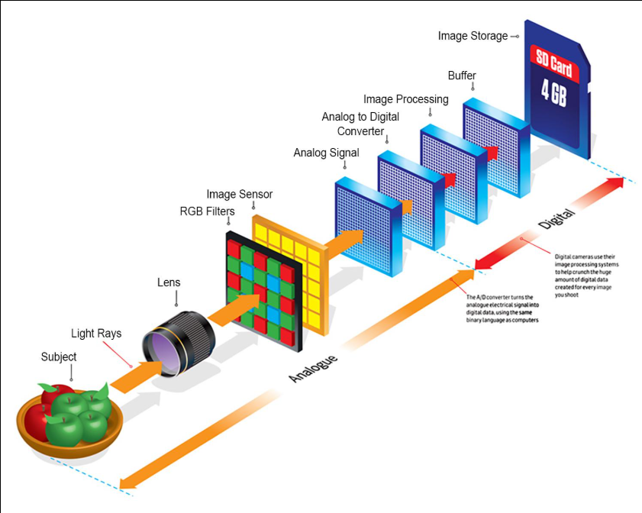
Image Acquisition & Image Formation
Image Acquisition
Definition
Image acquisition is the process of capturing a real-world scene using an imaging device and converting it into a digital image.
Process
Light falls on the object.
The object reflects light.
The camera lens focuses the light.
The image sensor captures the focused image.
The image is converted into digital form.

Slide 4
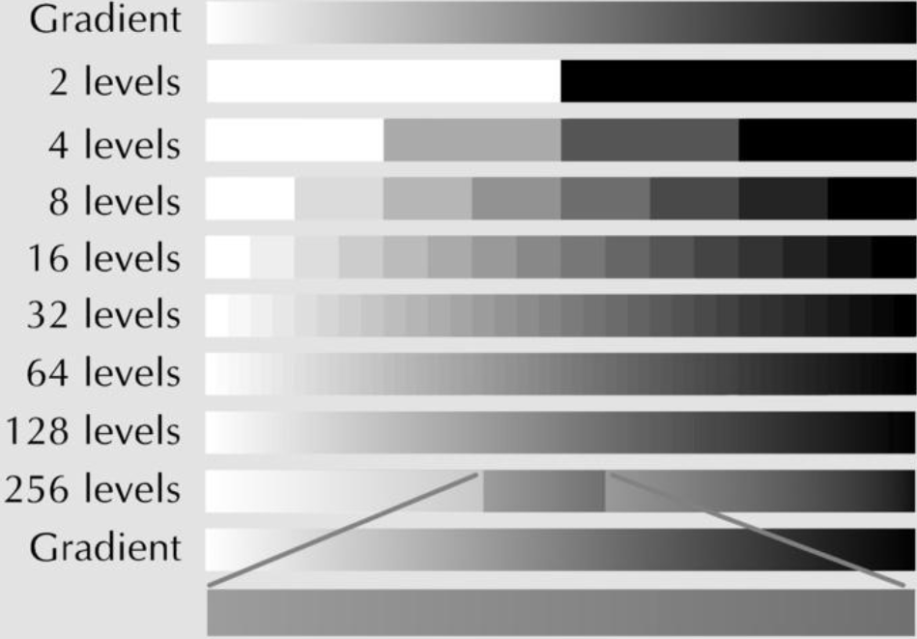
Sampling and Quantization
Sampling
Definition
Sampling converts a continuous image into a discrete grid of pixels.
Purpose
Determines spatial resolution.
Controls the amount of image detail.
Higher sampling → Better image quality.
Lower sampling → Pixelated image.

Slide 5
Quantization
Definition
Quantization is the process of converting continuous pixel intensity values into a finite number of discrete digital levels. It assigns each pixel to the nearest available intensity level, making the image suitable for digital storage and processing.
How Quantization Works
The image sensor captures continuous intensity values.
These values are rounded to the nearest digital level.
Each pixel is assigned a binary value based on the selected bit depth.
Higher bit depth provides more intensity levels and smoother image quality.

Slide 6
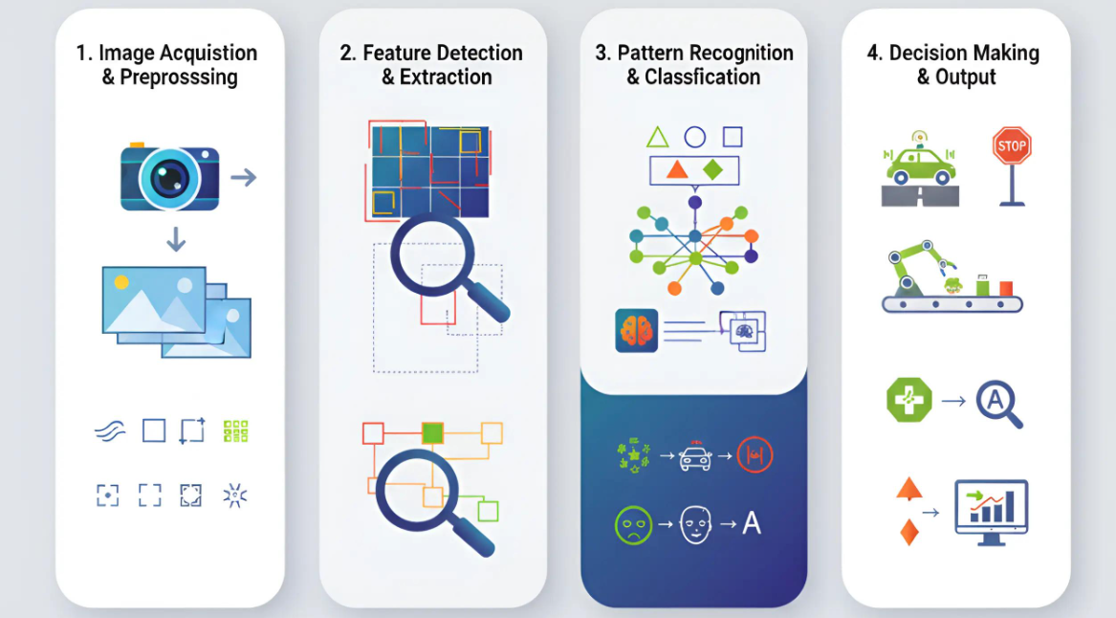
Image Processing Pipeline
This slide explains the complete workflow. Every stage depends on the previous one. If image acquisition or sampling is poor, the computer vision system cannot make accurate decisions.

Slide 7
Computer Vision Applications Real-World Engineering Applications
Domain | Application
Healthcare | Tumor Detection, MRI Analysis
Transportation | Autonomous Vehicles, Traffic Monitoring
Manufacturing | Quality Inspection, Defect Detection
Agriculture | Crop Disease Detection
Security | Face Recognition, CCTV Surveillance
Robotics | Navigation and Object Detection

Slide 8
Challenges
Sensitive to poor lighting conditions.
Image noise affects processing accuracy.
Motion blur reduces image clarity.
Low-resolution images lose important details.
Requires high computational power.
Environmental conditions can affect image quality
Object occlusion makes recognition difficult.
Advantages
Improves image quality for better analysis.
Reduces manual inspection and human errors.
Handles large volumes of image data
efficiently.
Provides reliable and consistent results.
Enhances decision-making using visual data.
Works effectively in automation and robotics.

Slide 9
Conclusion
Digital image fundamentals provide the foundation for representing images as pixels.
Image acquisition captures real-world scenes using cameras and sensors. Image formation creates a focused image through optical lenses.
Sampling converts the image into pixels, while quantization converts intensity values into digital levels.
Computer Vision analyzes these digital images using AI algorithms to recognize objects, classify scenes, and make intelligent decisions.

Slide 10
Thank you

